Slide 1
SOCRATIVE

Slide 2
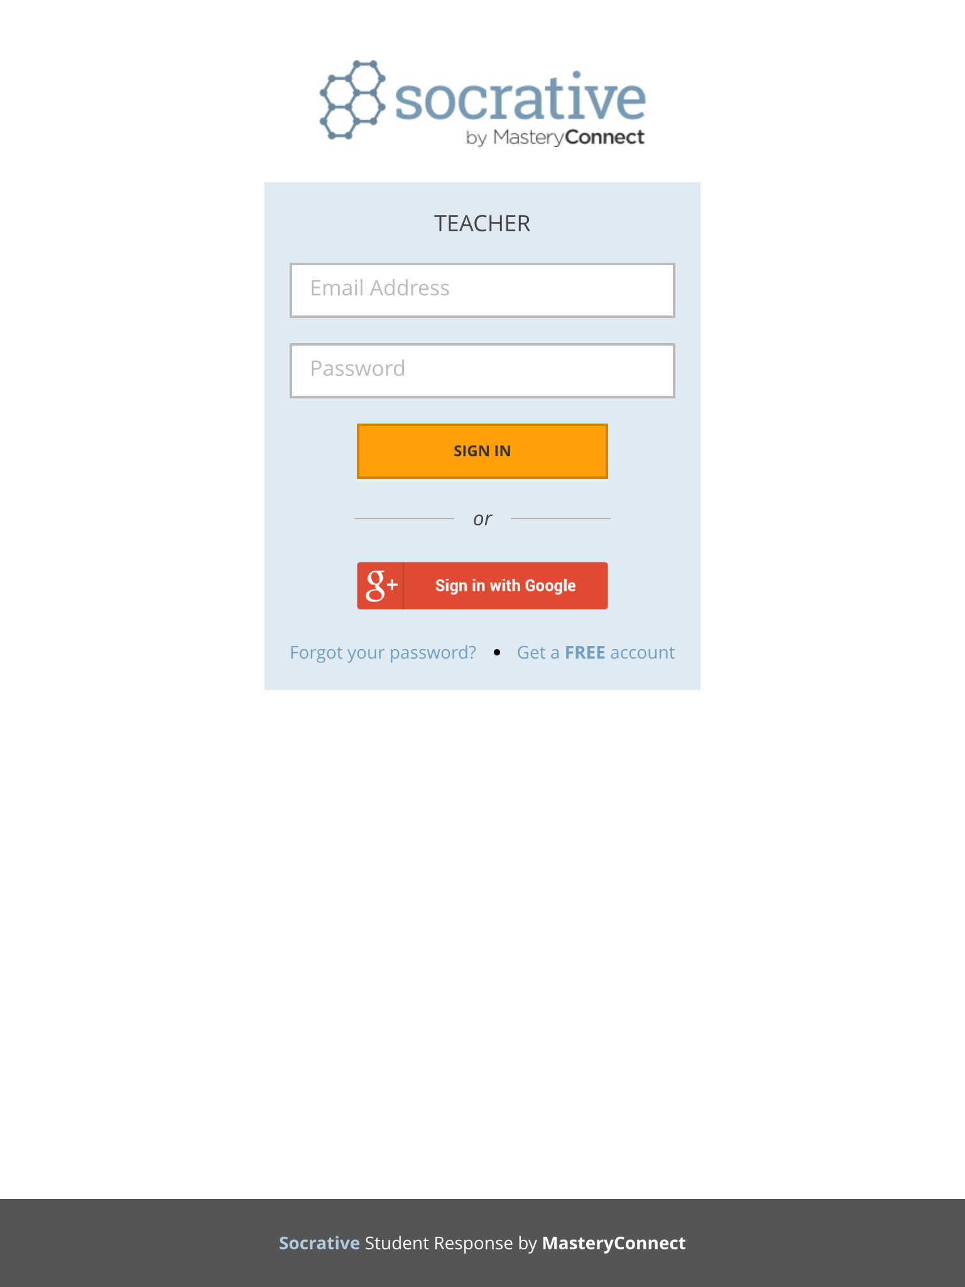
Firstly, login to the system through the teacher portal.

Slide 3
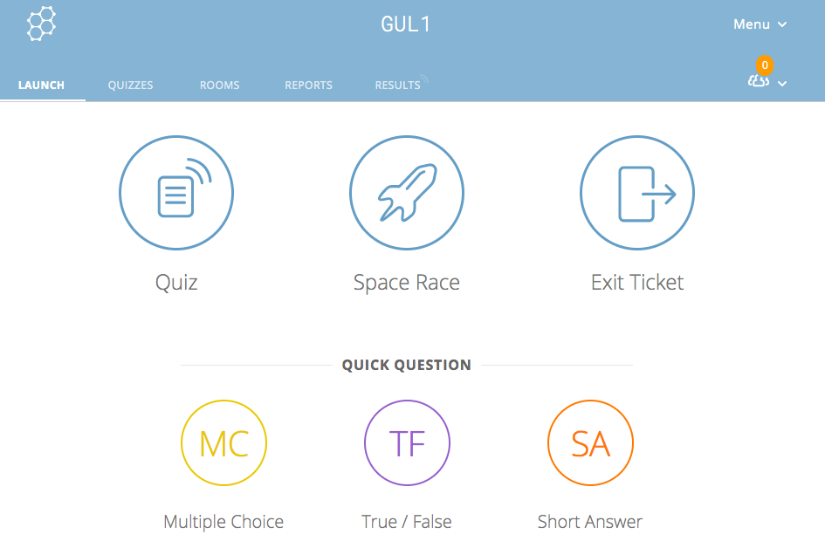
Your personalized teacher code
In order to start an existing quiz, the
«Start Quiz» option must be selected.
THE FIRST SCREEN THAT COMES UP ON THE APPLICATION
If the system is entered for the first time, then a question must first be written.

Slide 4
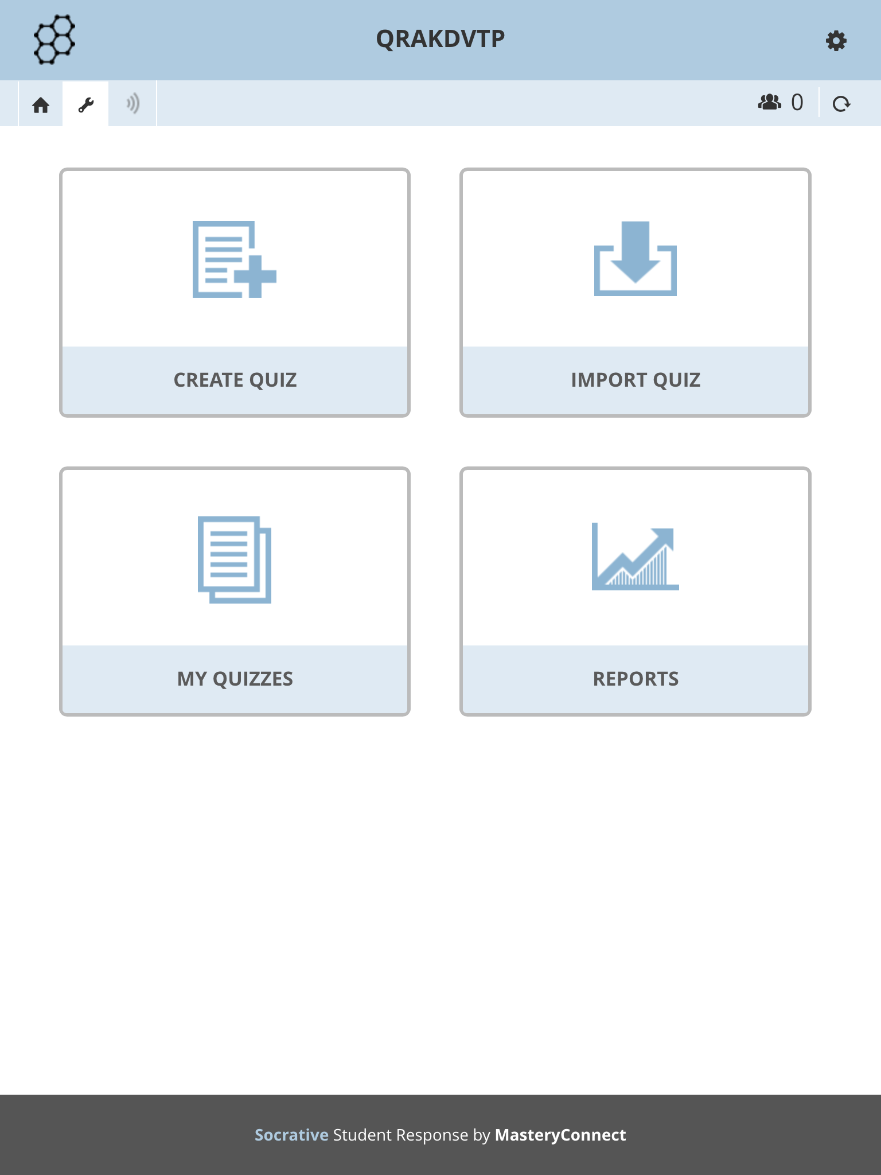
When this section on the screen is selected, we are faced with the option of creating a quiz or selecting an existing quiz.

Slide 5
This section must be selected to create a quiz.

Slide 6
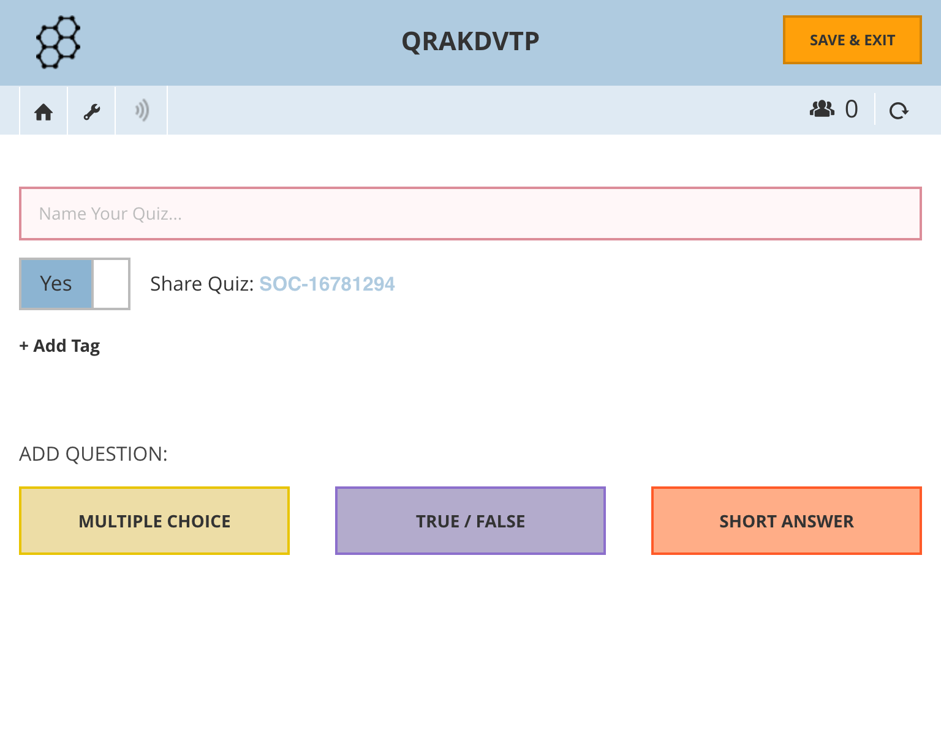
A quiz name is given.

Slide 7
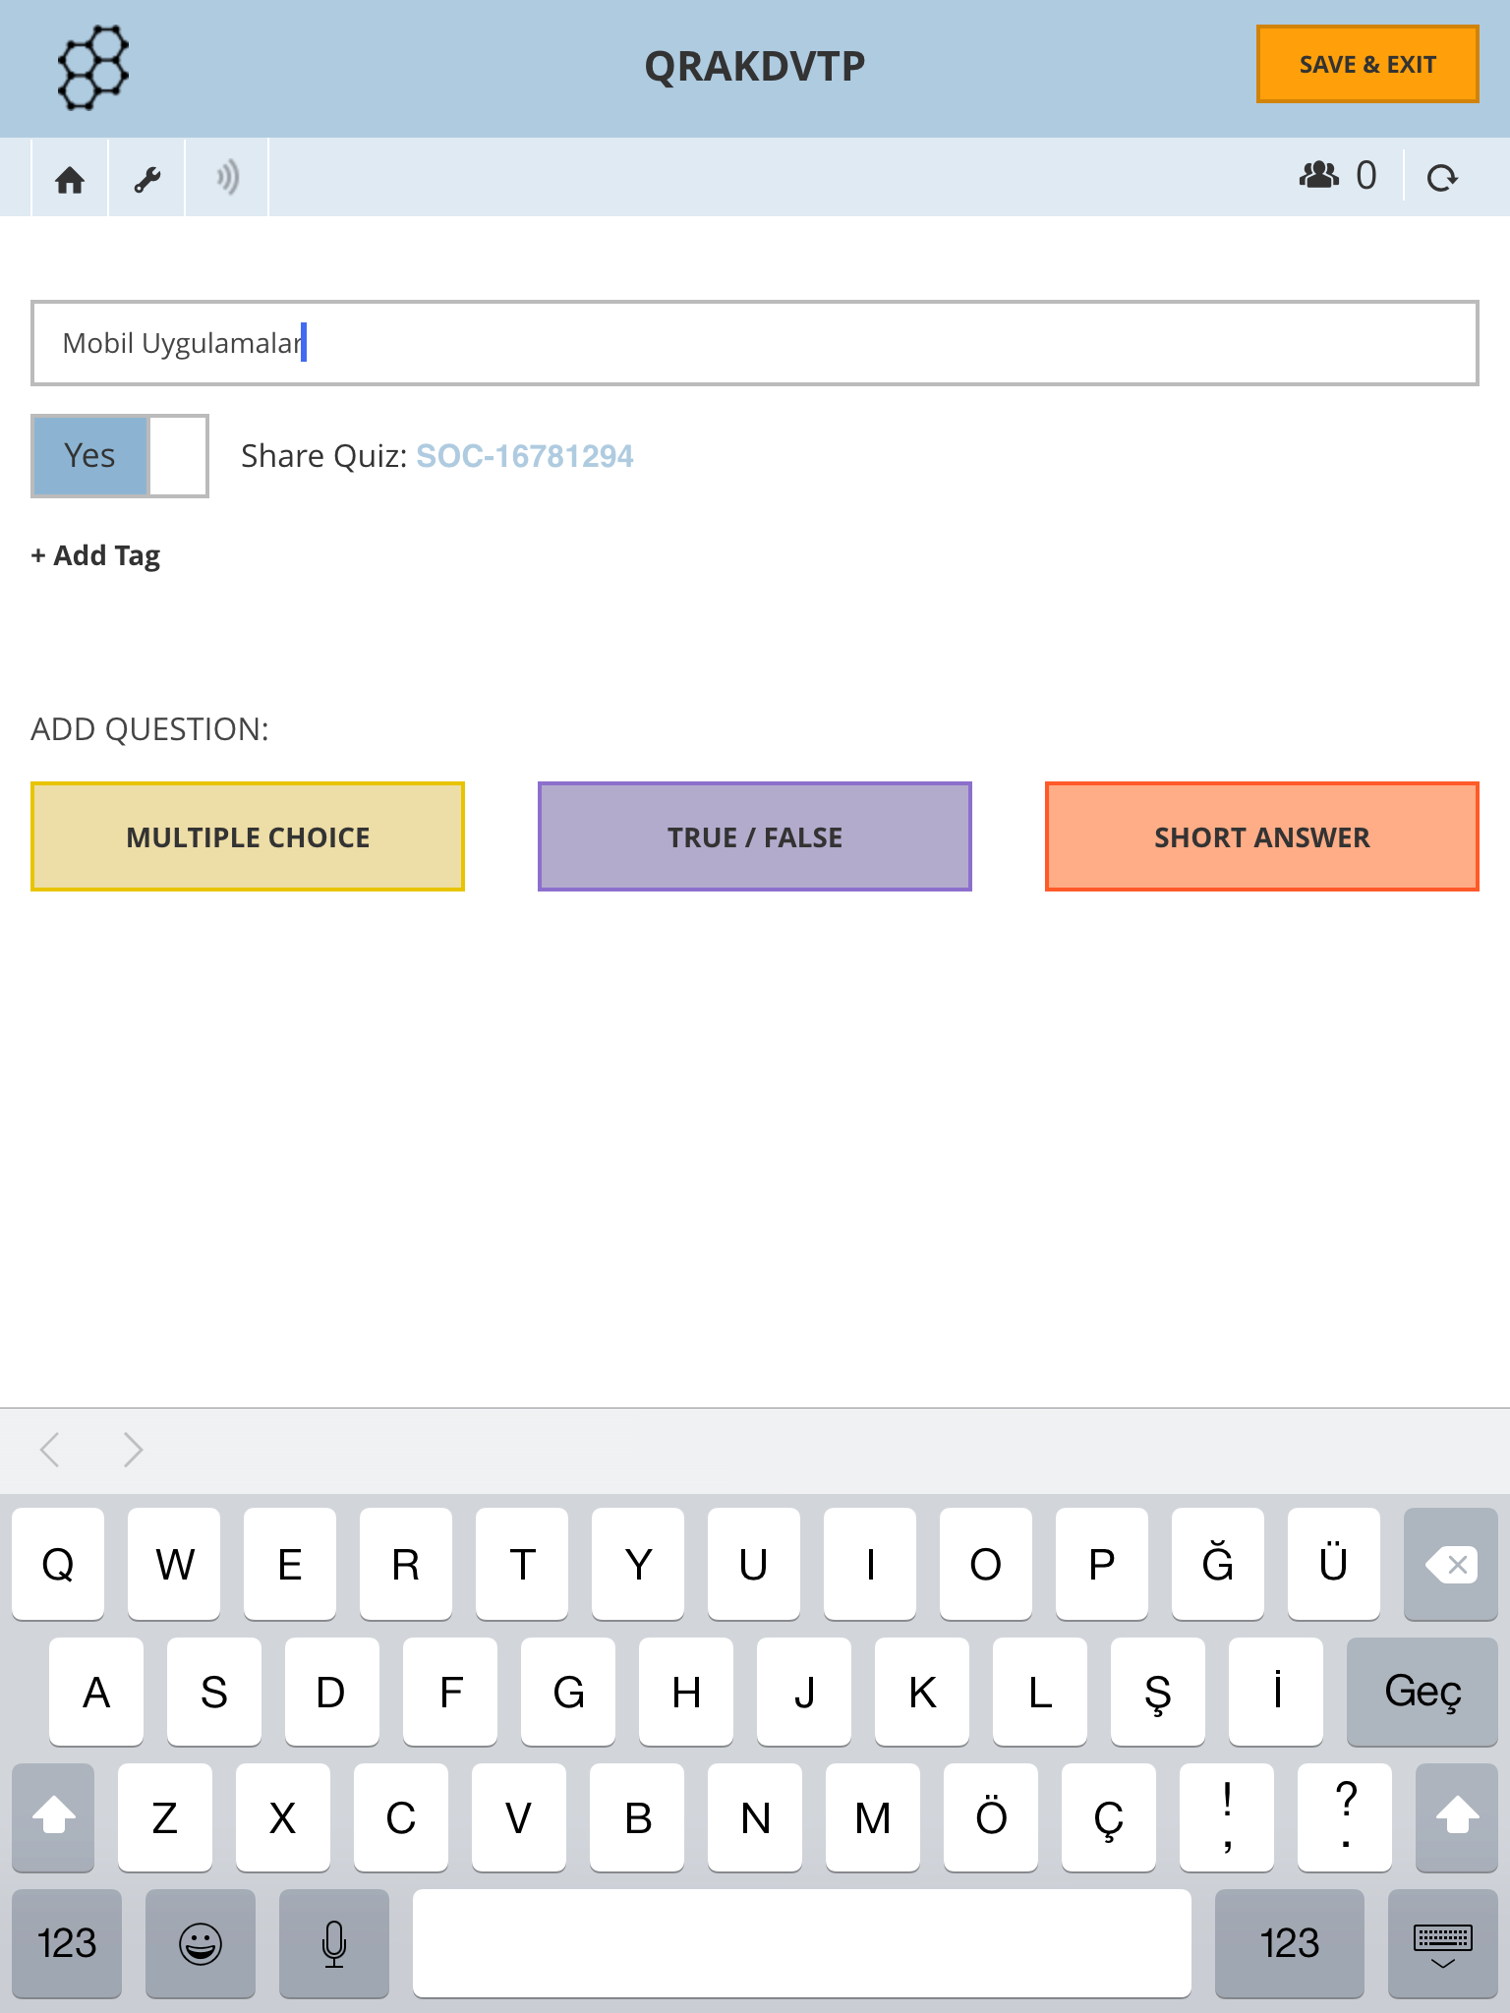
In this section, we start to write our question.
* Multiple choice
* True/False
* Short Answer

Slide 8
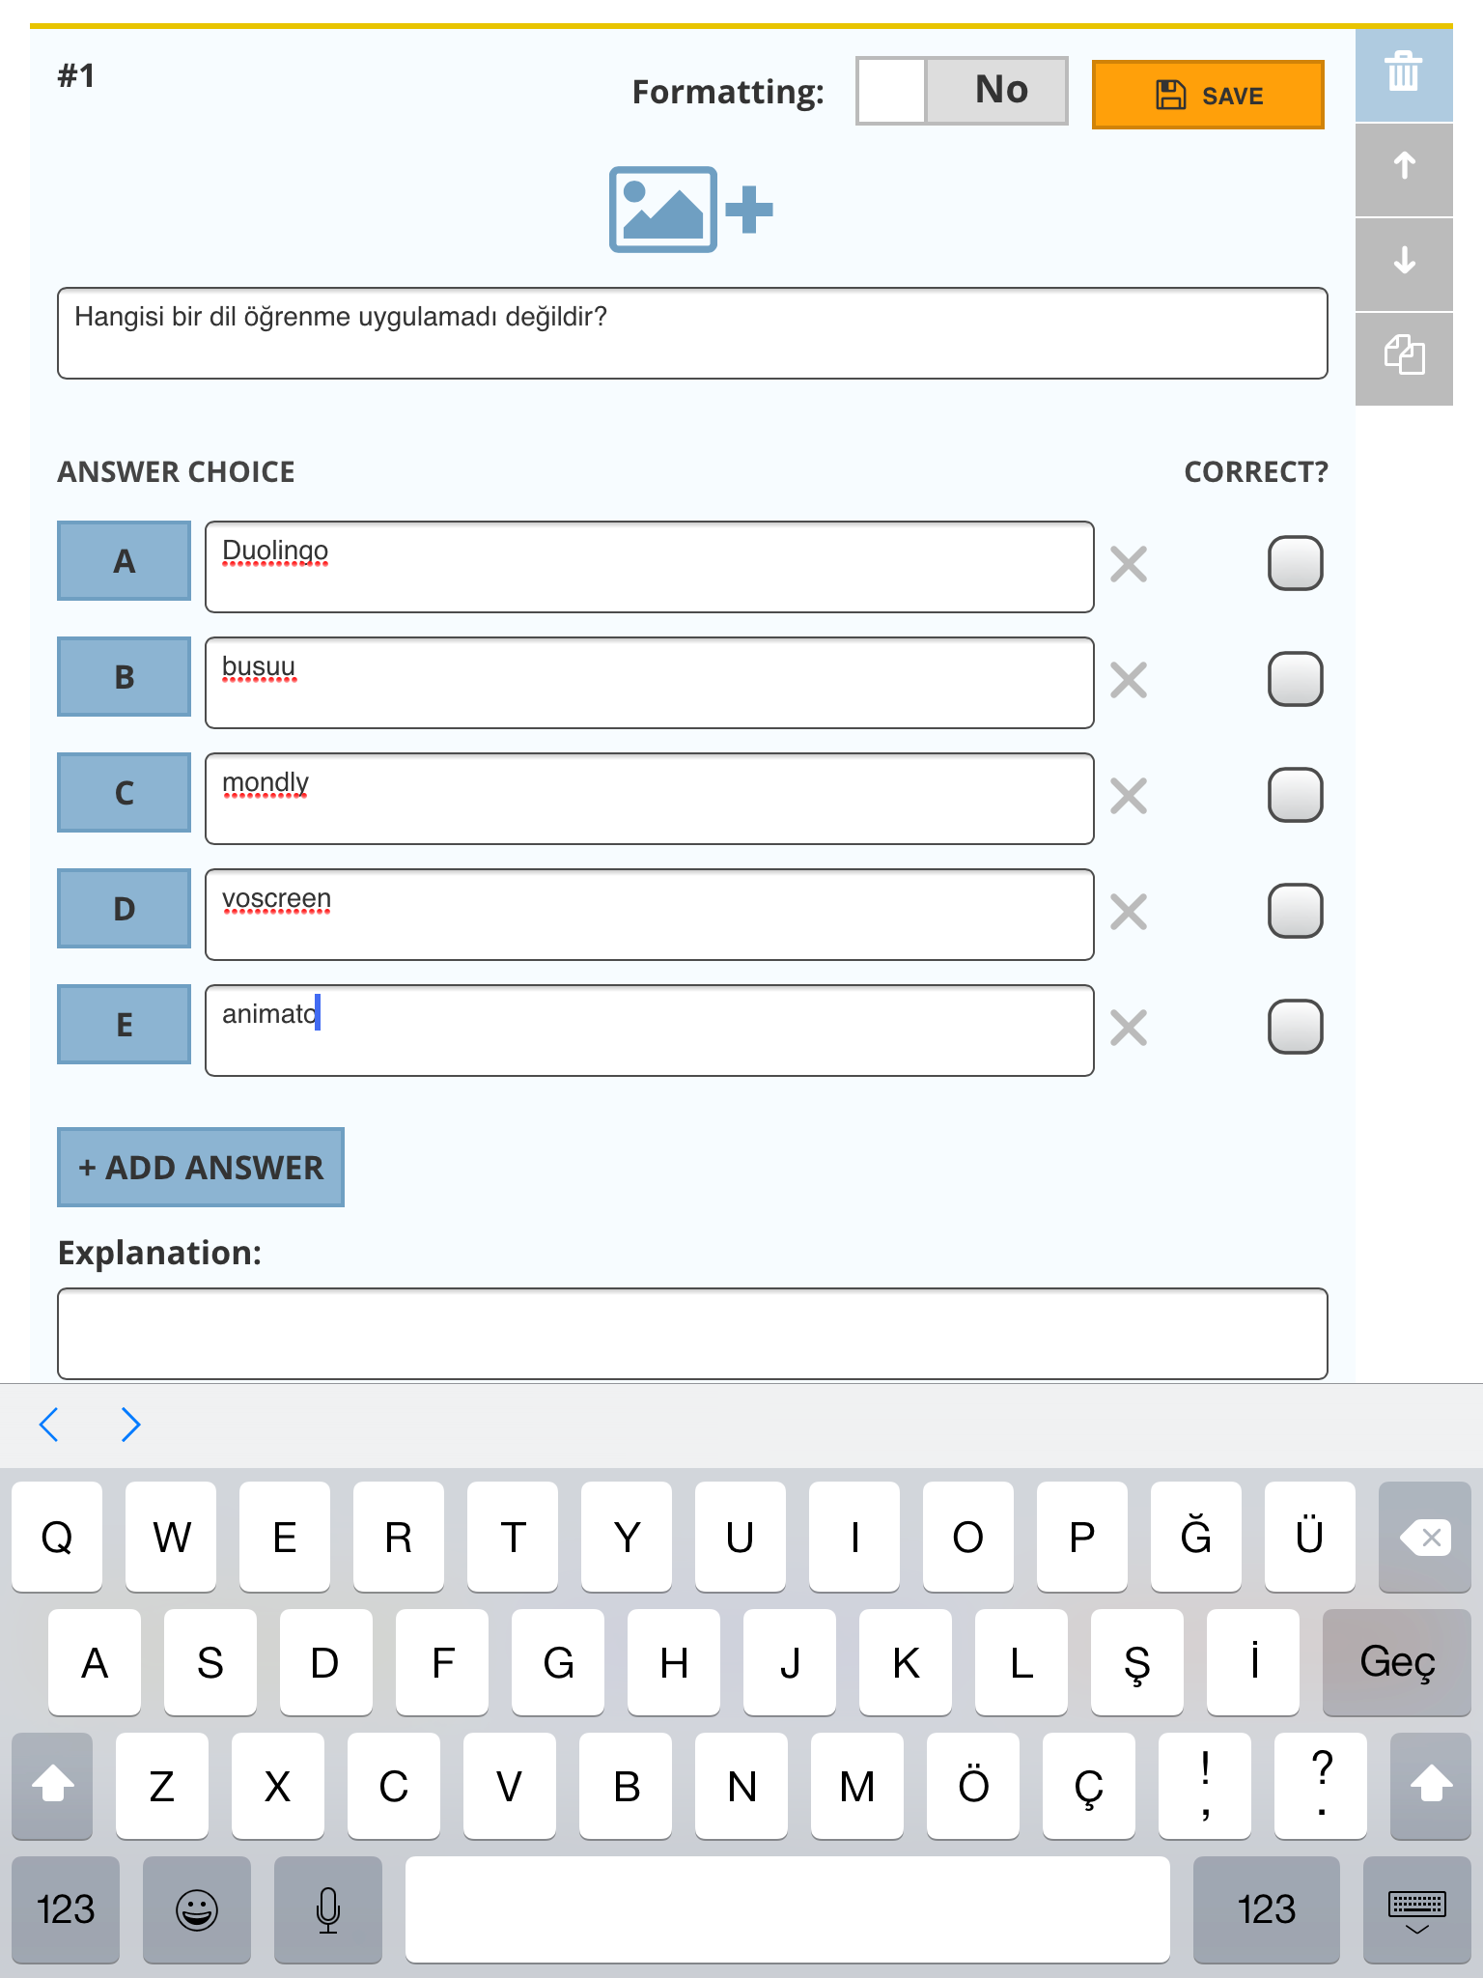
Let’s write a multiple choice question. You can add as many choices as you want.

Slide 9
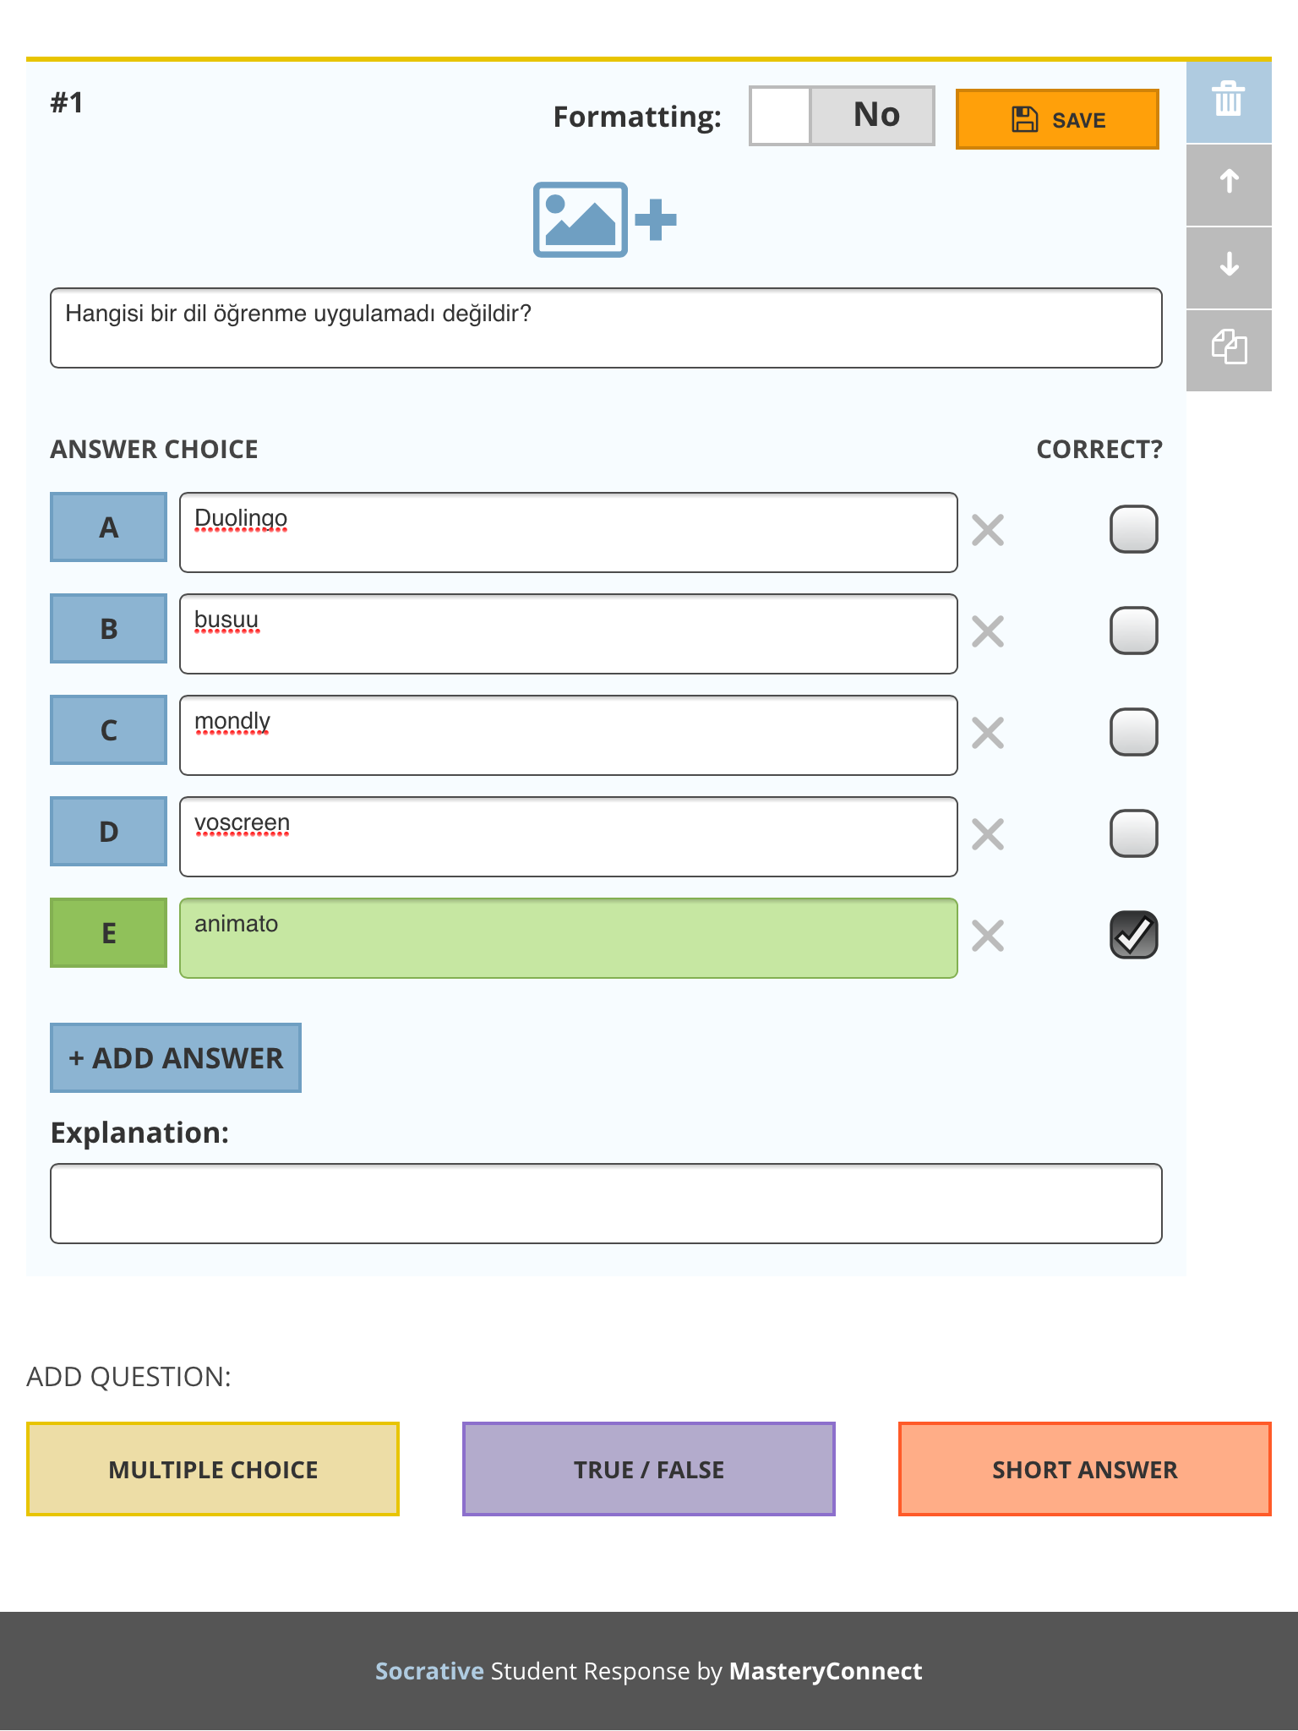
Do not forget to select the correct answer.

Slide 10
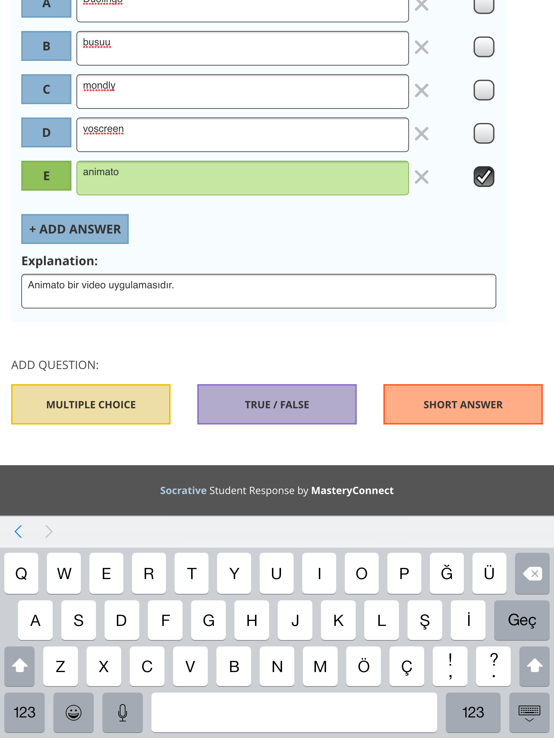

EXPLANATION is the section where you can add an explanation related to the answer.
You can add another question by selecting «Add Question» and choosing the type of question.

Slide 11
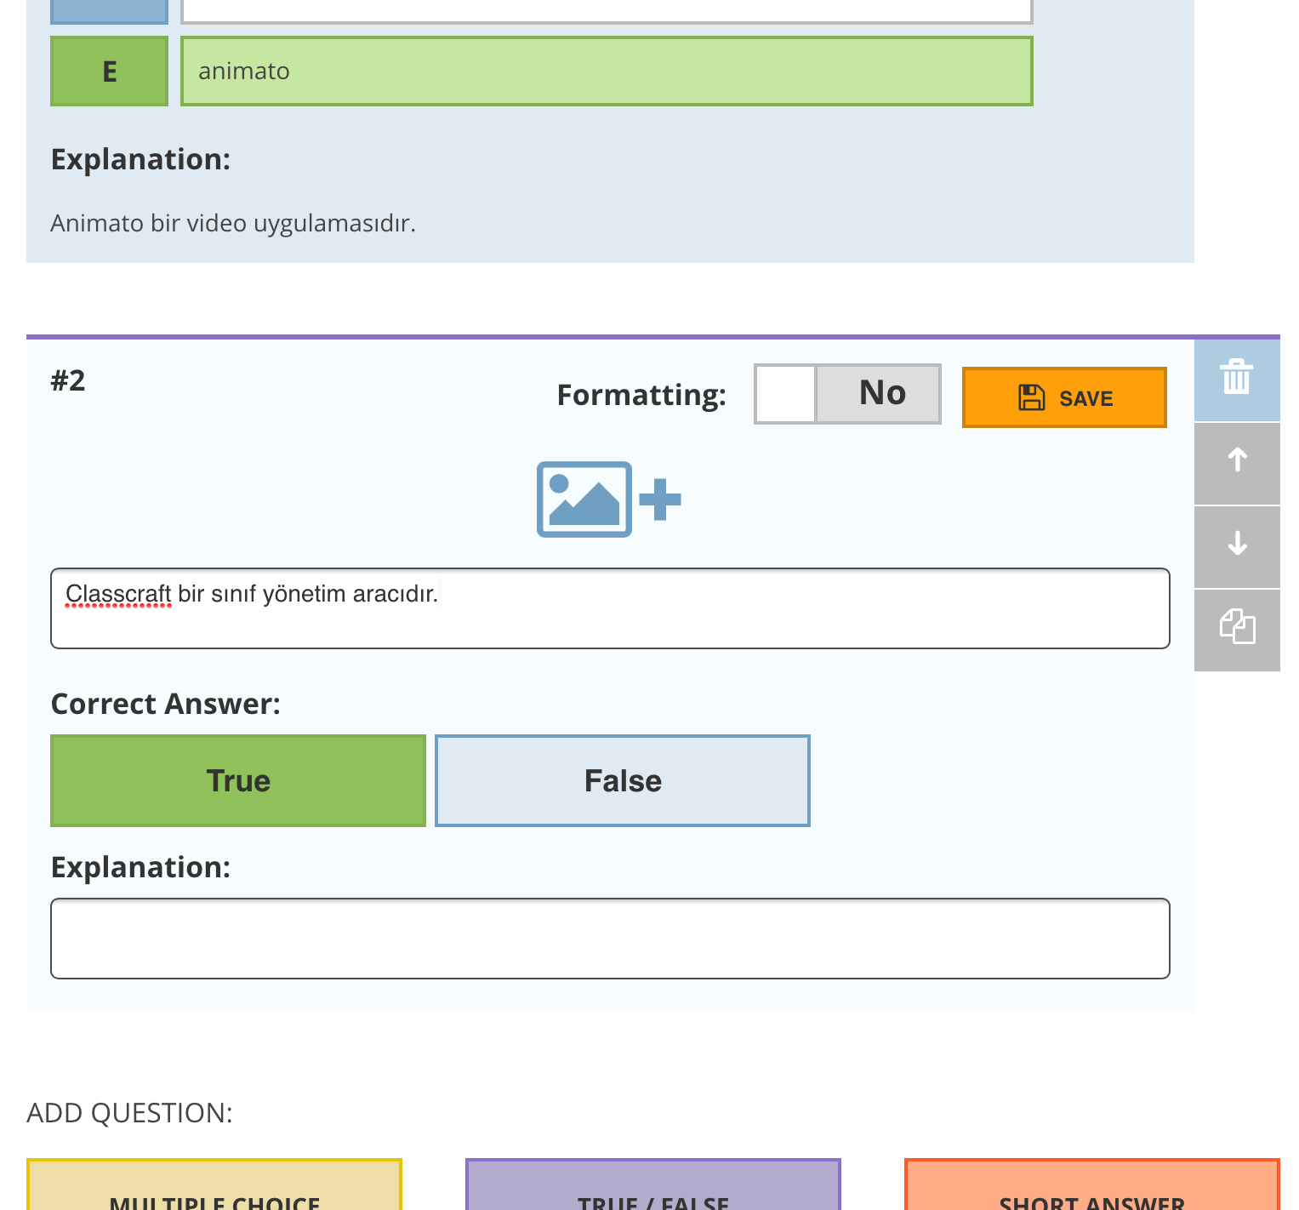
Let the second question be a True-False question.

Slide 12
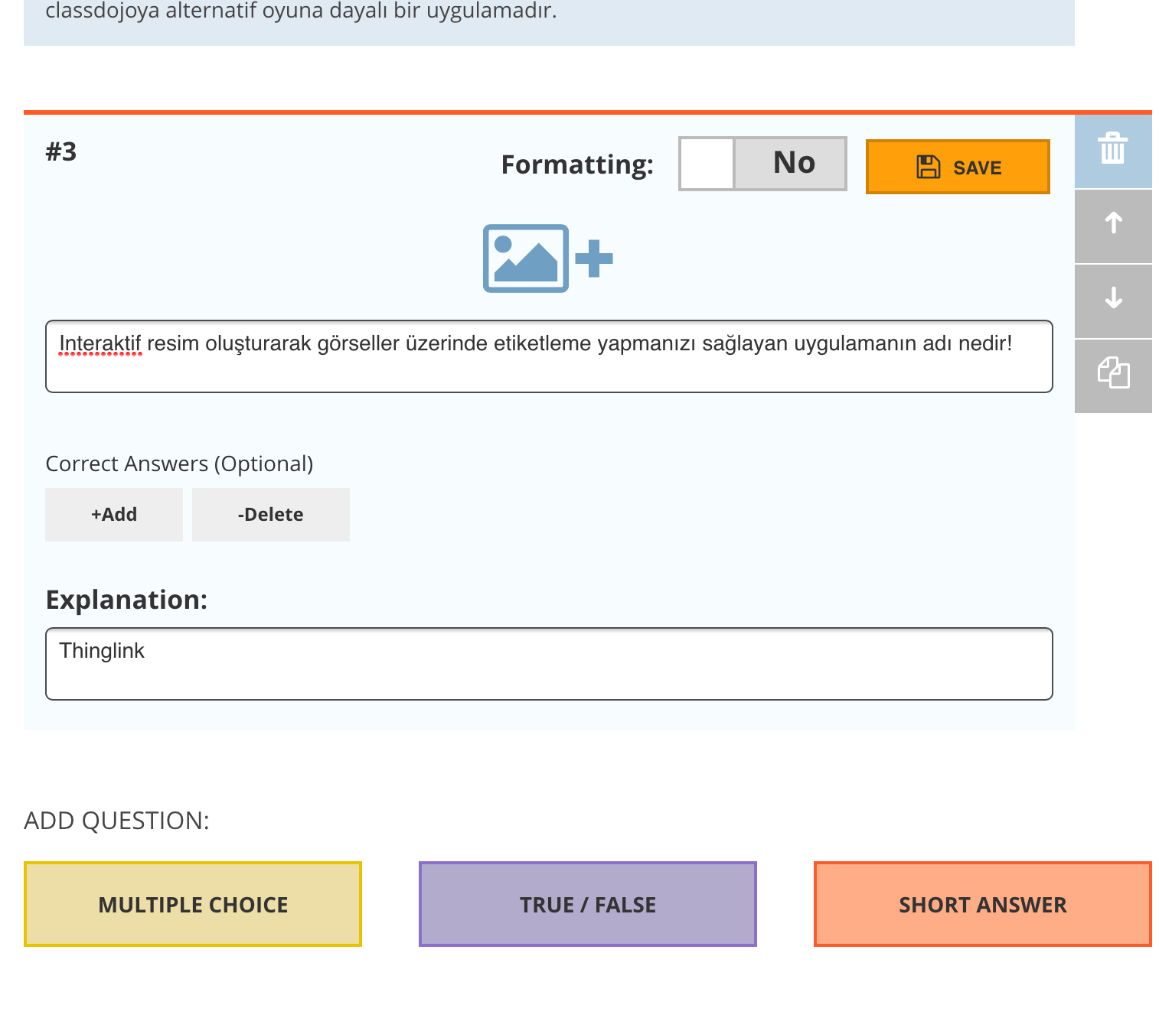
And let the 3rd question be a short answer question.

Slide 13
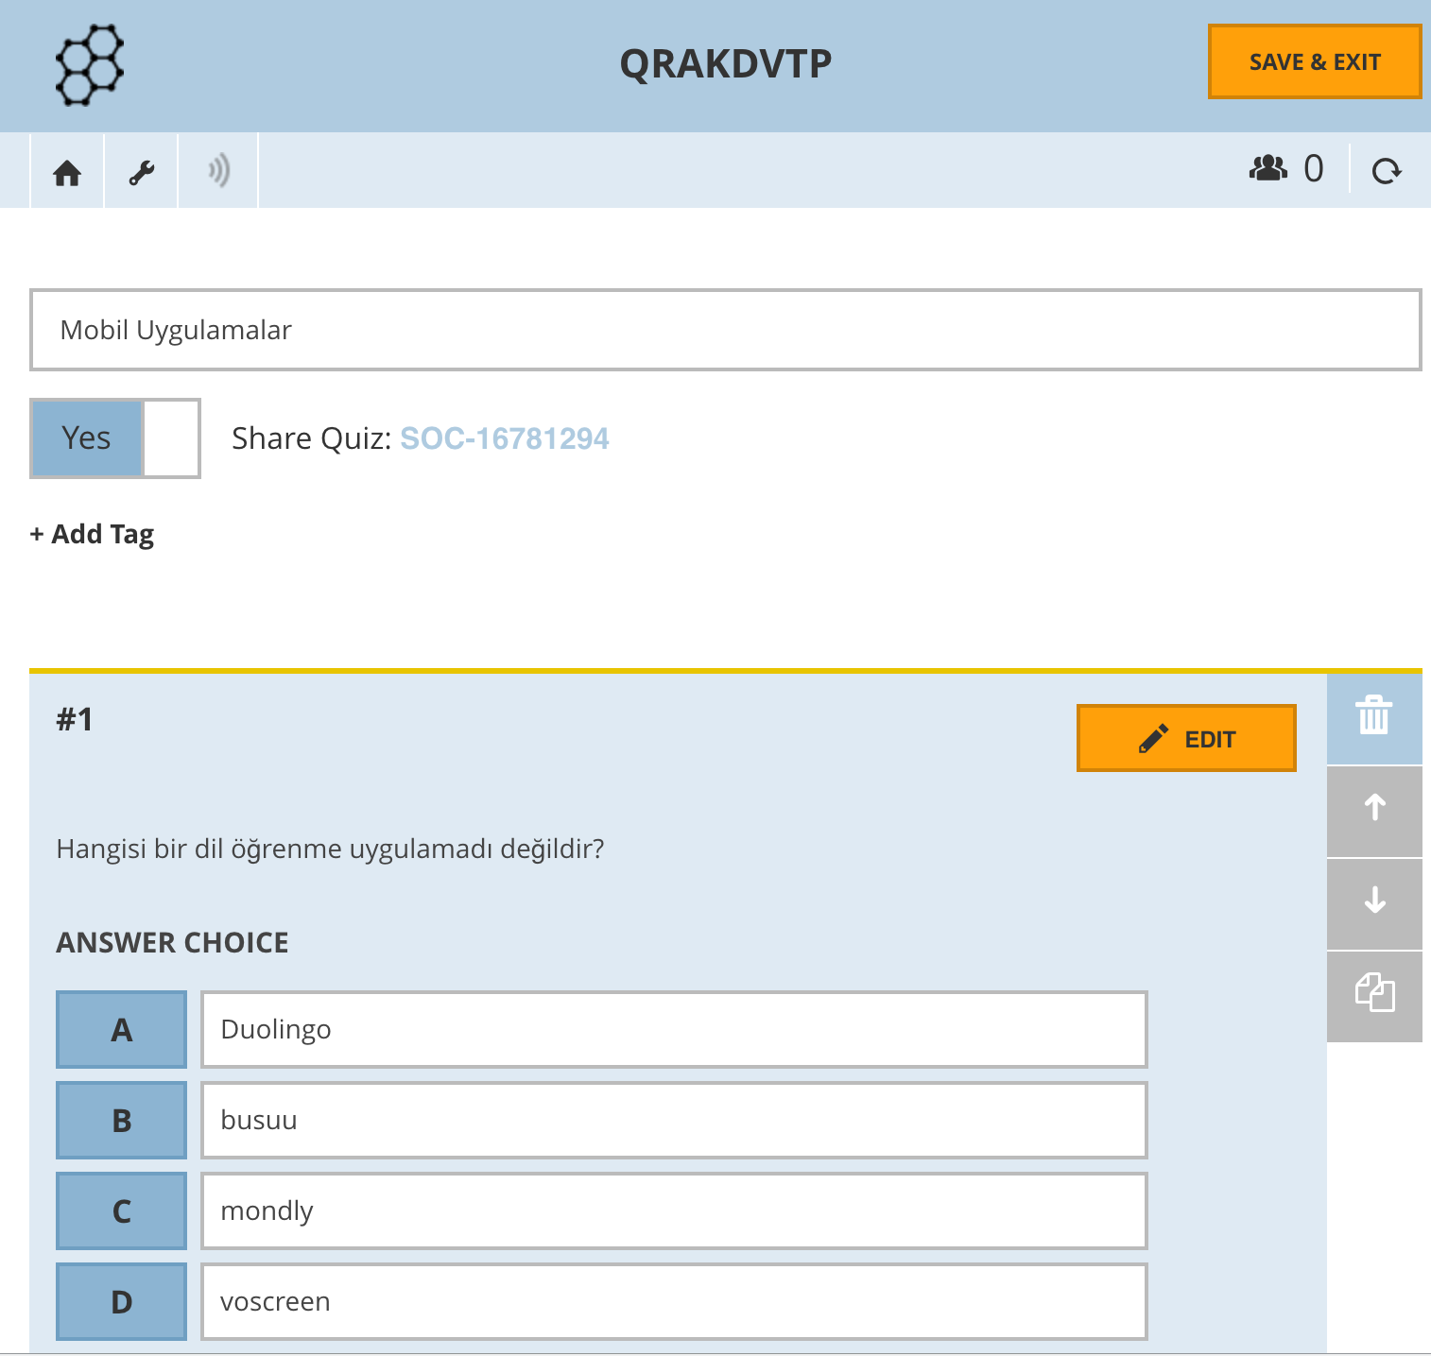
The prepared exam can be saved by clicking here.

Slide 14
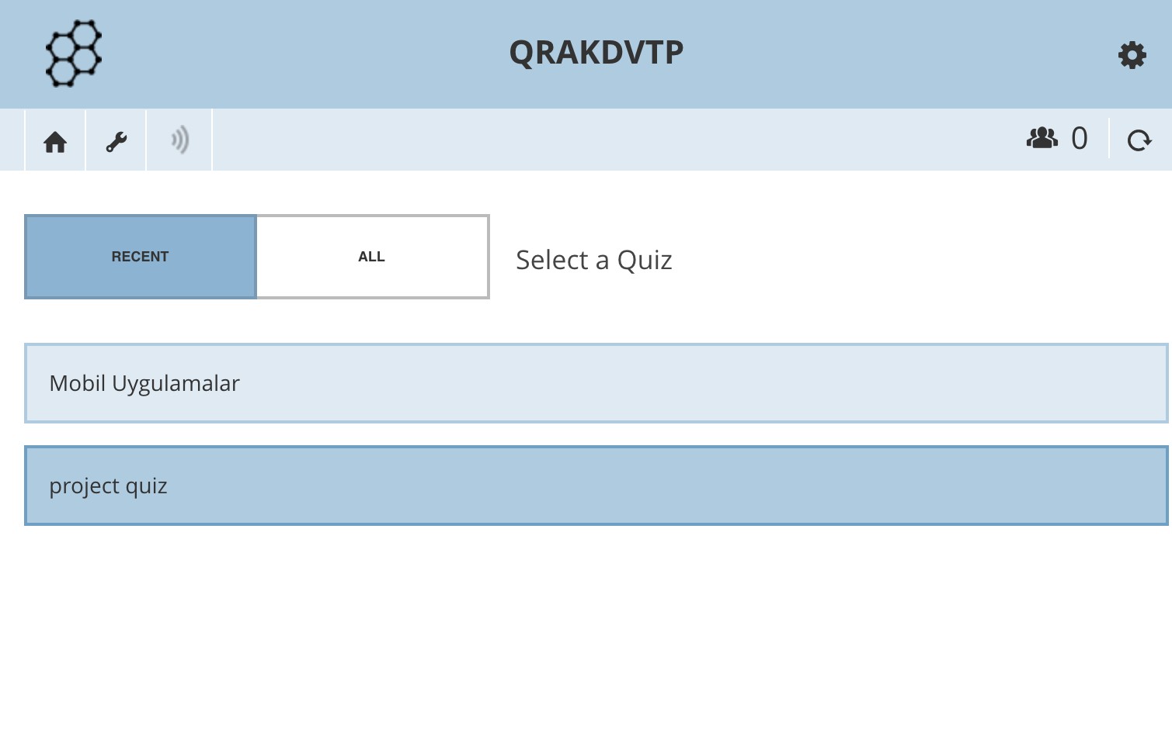
When you return to the My Quizzes section you, will see your previously prepared quizzes.

Slide 15
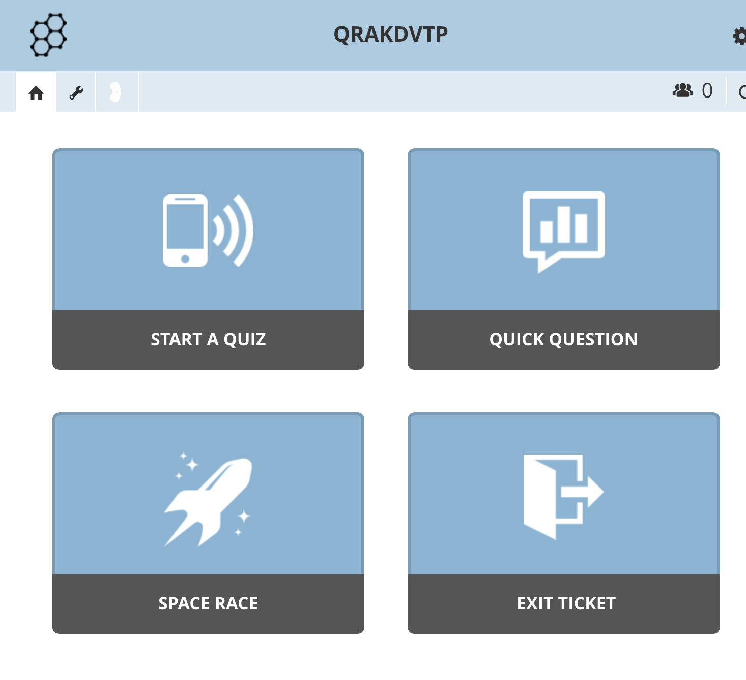
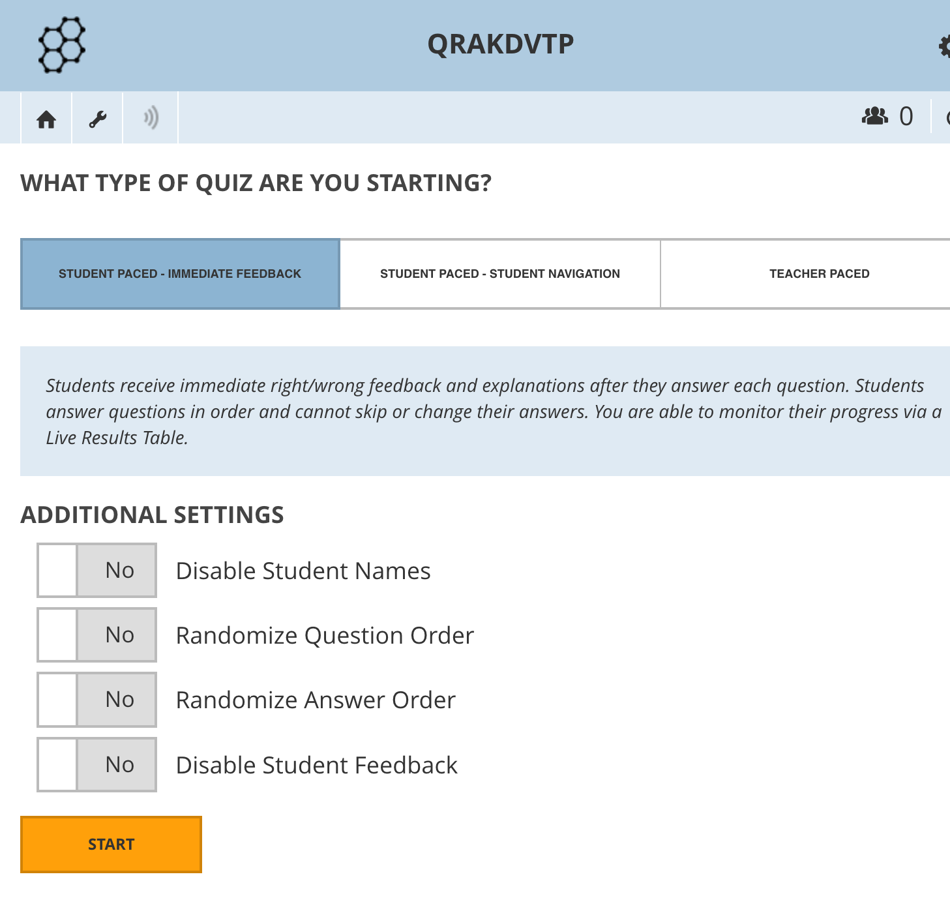
To begin the quiz we go back to the Start Quiz section form the main screen. We select the name of the quiz we want to do.
We can begin the quiz by clicking on the Start button.
Notes:
Multiple choice tests
Ture/False questions
Short answer questions
**You can view the students answes as a resport, graphic or table form.
In the quick question section you can ask your students a question orally and quickly collect the answers.
‘SPACE RACE’ section is ideal for students who will race against eachother in teams.
You can select your exam and how many teams you want to create.

Slide 16
HOW DO STUDENTS SEE THE TEST ON THE SOCRATIVE STUDENT APPLICATION?

Slide 17
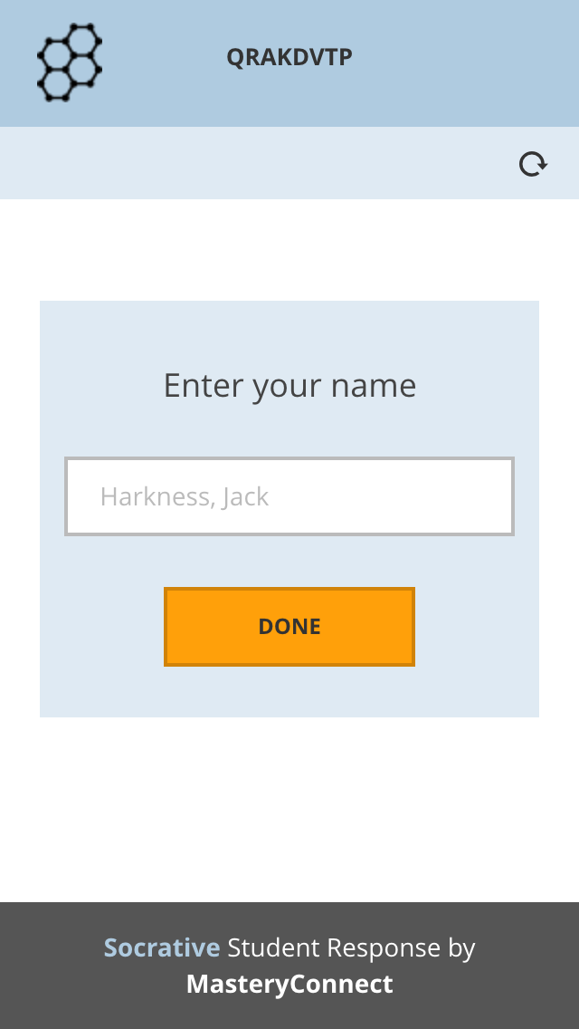
Students must download the «Socrative Student» application. After entering the private teacher code, they must write their name.

Slide 18
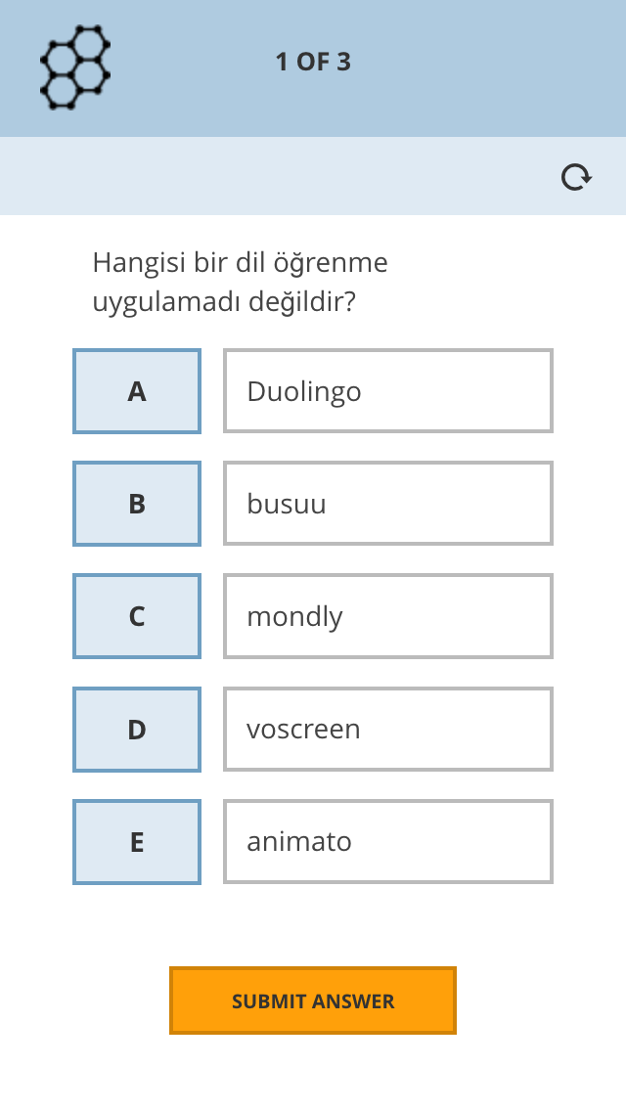
The correct answer must be selected and then «Submit Answer» .

Slide 19
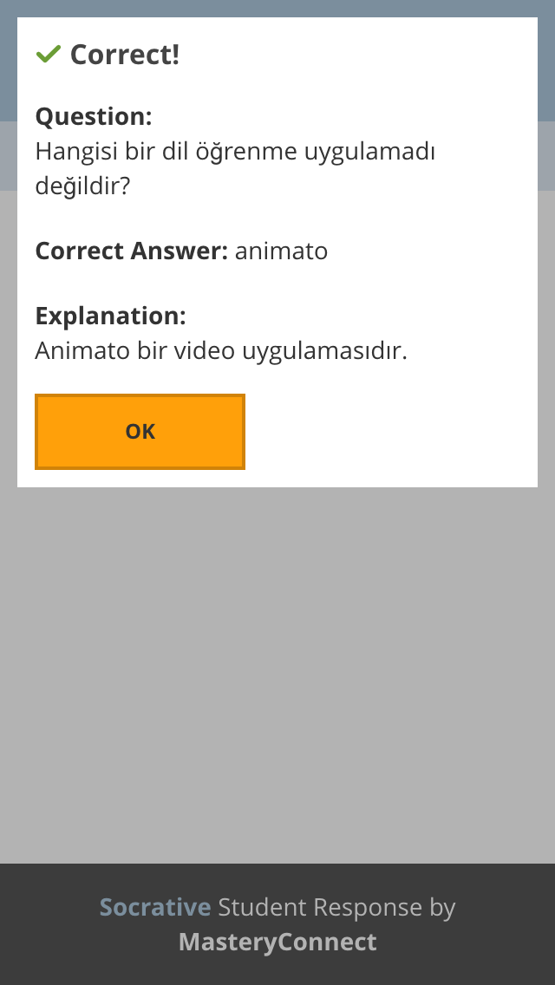

Slide 20
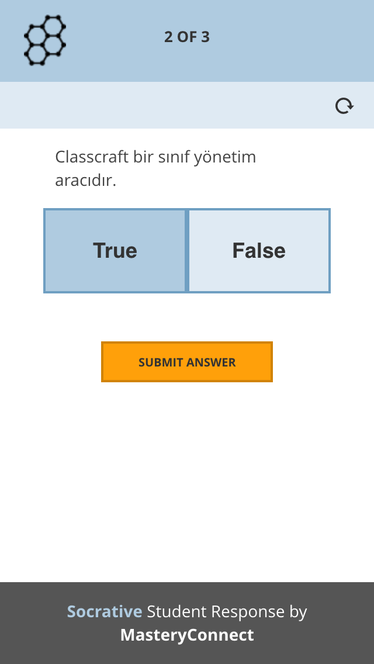
2nd QUESTION

Slide 21
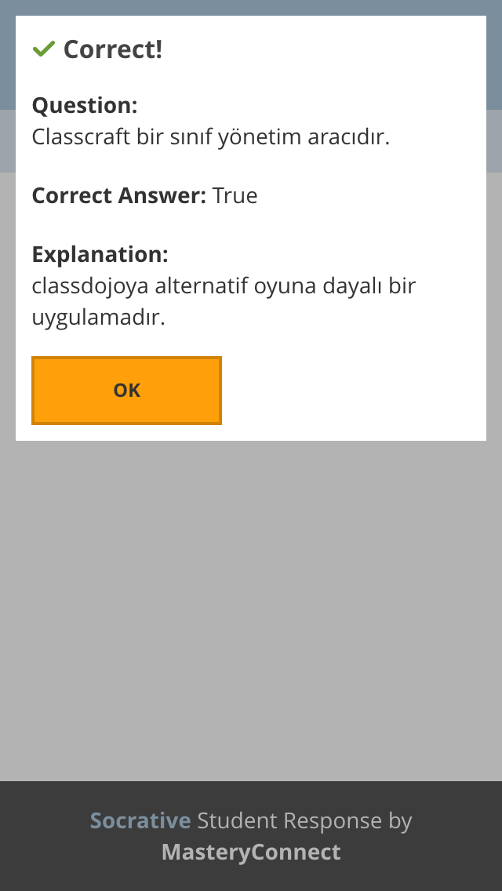
This shows the student whether they have given a correct or incorrect answer. If you have written an explanation, that will also be shown.

Slide 22
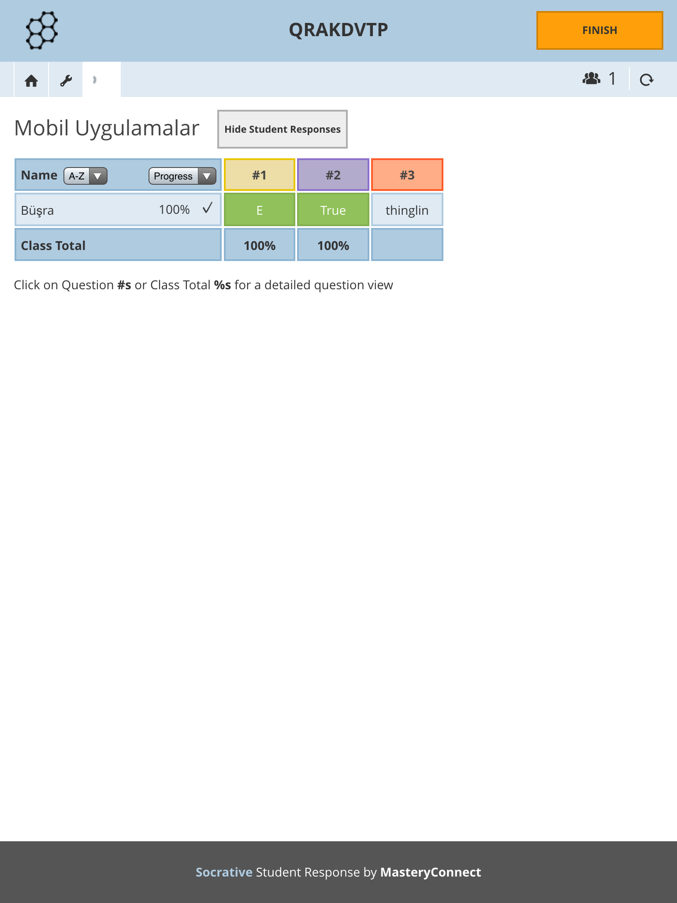
Here, the teacher can see the answers given by each student to the questions.

Slide 23
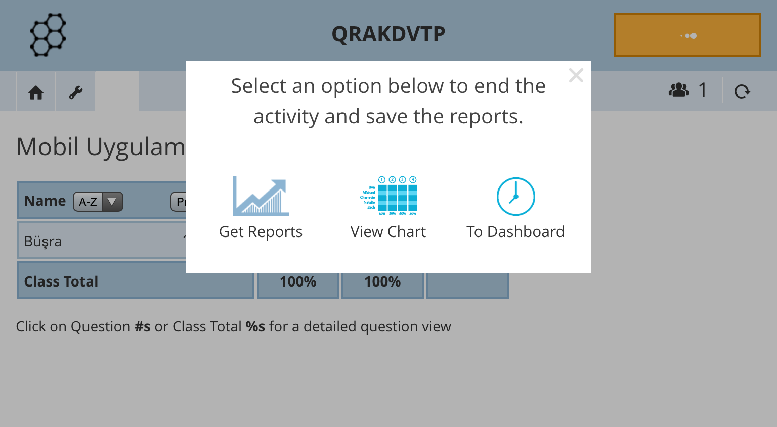
Students can see their answers in a report. They can view them as a graph or a table.

Slide 24

The ‘Exit ticket’ section
The “Exit Ticket” tab is made up of 3 fixed questions and students are asked to answer these questions when leaving the class.
How well did you understand today’s topic?
What did you learn today?
Answer the question asked by your teacher.

Slide 25
The ‘Quick question’ section
In this section, you can ask questions verbally to your students and receive quick replies.

Slide 26
‘SPACE RACE’ section
This section is ideal for students who will race in teams.
You can choose the quiz and how many groups will be participating.

Slide 27



